Slide 1
Glass Furnace Temperature Prediction (Regression)
Ege DEMİR

Slide 2
Table of Contents
Problem and Dataset 3
Data Quality Issues 5
Feature Generation 11
Exploratory Data Analysis 13
Correlation to Target
Correlation Matrix
Analysis of Gas/Oxygen Columns
Data Preprocessing 20
Feature Selection
Outlier Removal
Standardization
Train-Test Split
Modelling and Evaluation 23
Modelling
MSE, MAE, R^2 scores
Residual Distributions
Feature Importance
Without TEMP_0912 28
Hyperparameter Optimization 32
Conclusion 34

Slide 3
Problem and the Dataset

Slide 4
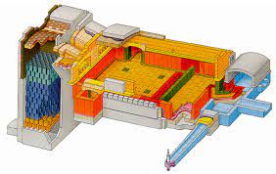
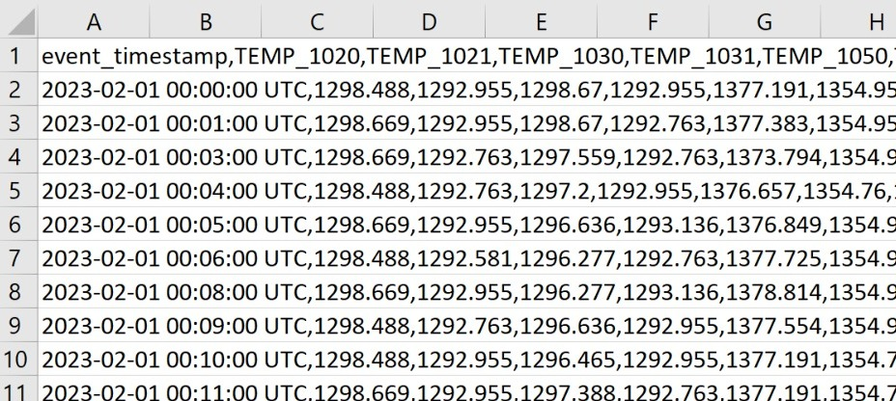
Dataset
Goal
We have a dataset with 39600 rows and 169 columns, acquired from the sensors of a glass furnace. It contains temperature, pressure, gas and oxygen information for different parts of the furnace.
We aim to predict the temperature for a specific location at the furnace (sensor 912).
We cannot use its values directly as a target variable because our prediction should be about the next minute. We must shift the target feature.

Slide 5
Data Quality Issues

Slide 6
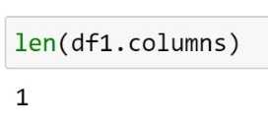
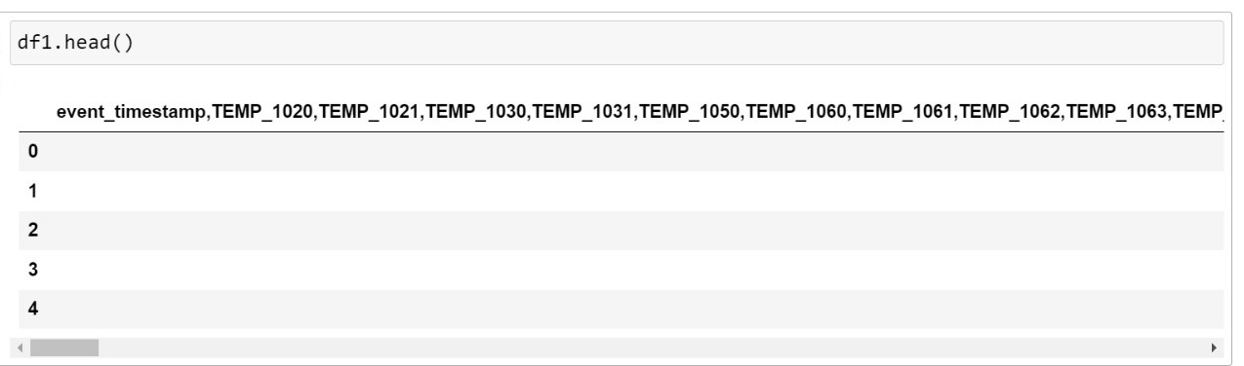
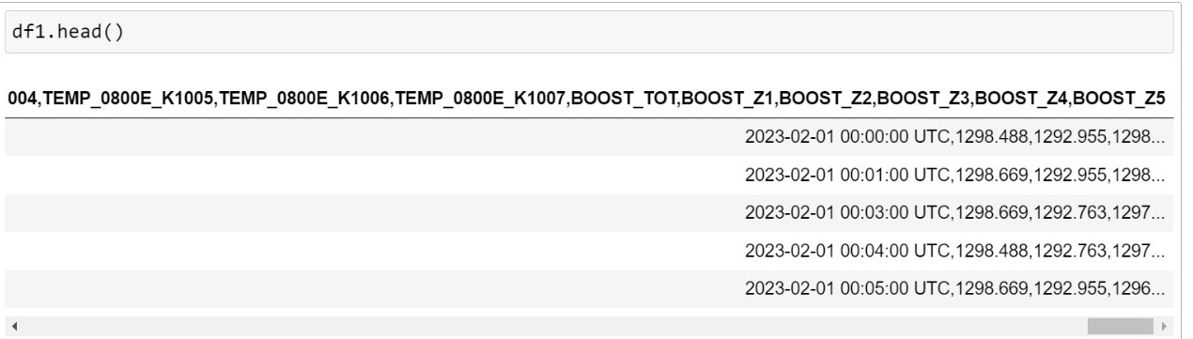
Raw Data
It may seem that the problem with the raw data is that it’s blank. But we can see that’s not the case when we check its column count. It seems blank because our DataFrame failed to parse the data from commas, and it took every entry as a whole string instead of an actual table with multiple columns.
Let’s fix that.

Slide 7
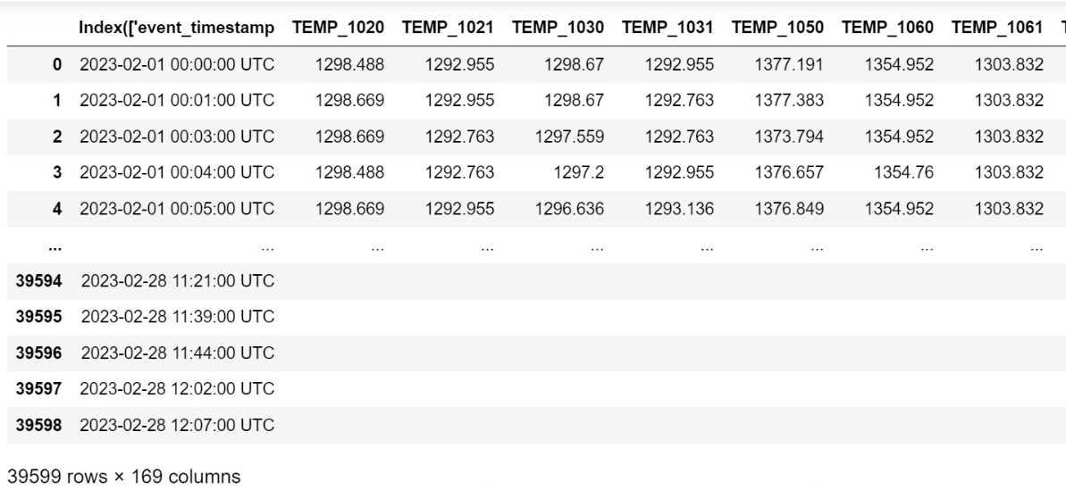
Blank Entries
Now, the data is columnized. But there is another problem. There are 5027 rows with blank entries. Let’s drop them.
Also, the name of the 1st column is corrupted. We should update that too.

Slide 8
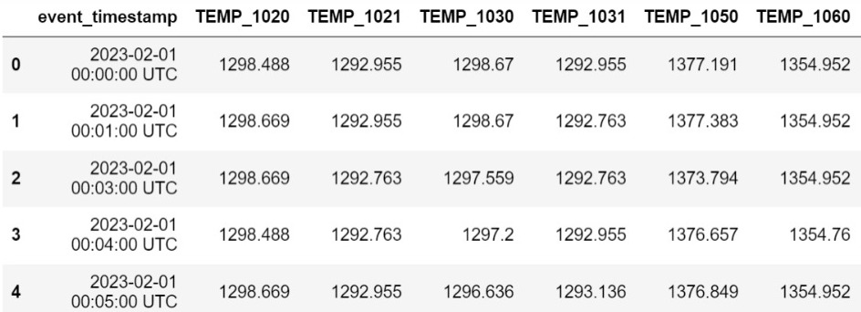
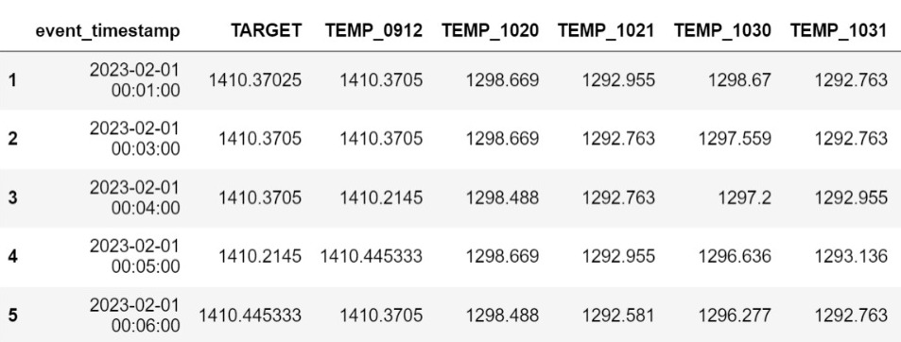
Target Variable
Let’s create our target variable by shifting TEMP_0912 column 1 index forward. Because we aim to predict the temperature of the sensor 912, in the next minute.
We should also convert the timestamp column’s entries from string to datetime, and also sort the DataFrame with reference to timestamp ascendingly.

Slide 9
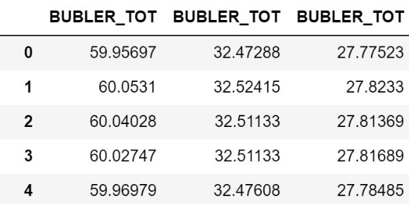
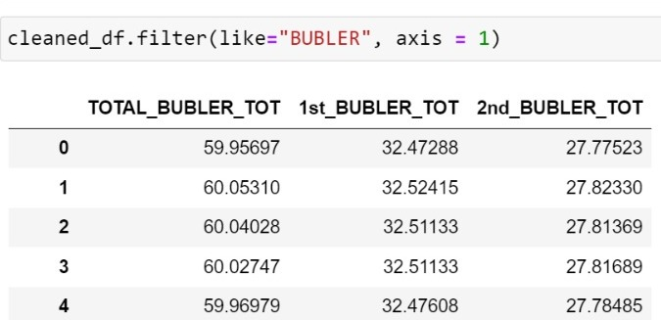
Duplicated Column Names
There are also multiple columns with the same name. Let’s update their names to avoid any confusion.

Slide 10
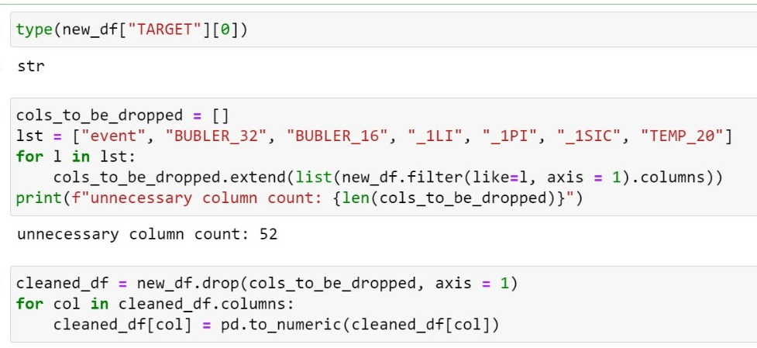
Wrong Data Type and Unnecessary Columns
As we can see, data type is string. We should make it numeric to make it regression friendly.
Also, we should drop the columns which are irrelevant to our problem. Notice that we drop the timestamp column too, because after the sorting, we don’t need it anymore.

Slide 11
Feature Generation

Slide 12
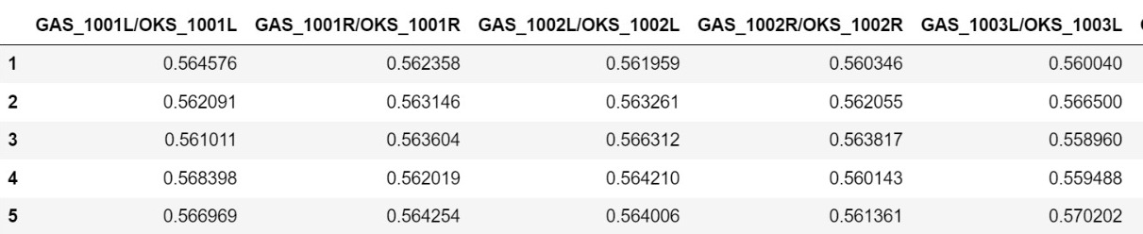
Generating Gas/Oxygen Columns
There are 14 locations at the furnace which has gas and oxygen sensors. From our domain knowledge, we know that furnace must keep gas/oxygen ratio at some level. So, it makes sense to have features to store that information. After we generate them, we know have 14 new features.

Slide 13
Exploratory Data Analysis

Slide 14
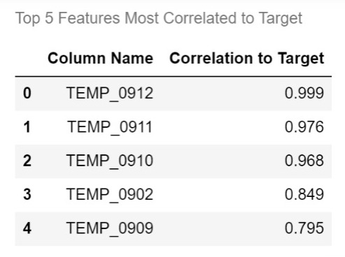
Correlation to Target
As expected, Target and TEMP_0912 is nearly %100 percent correlated. Their only difference is 1 downward shift after all.
More surprisingly, TEMP_0911 and TEMP_0910 is hugely correlated to target. It’s probably because their sensors are physically close to each other.

Slide 15
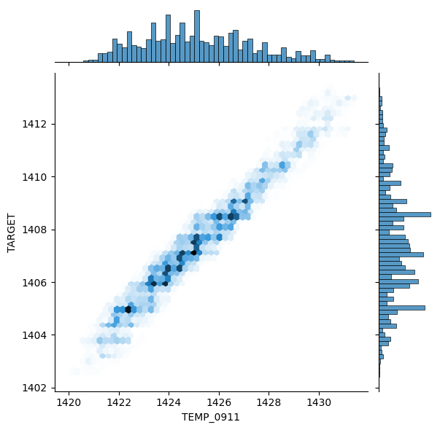
Correlation Between TEMP_0911 and Target
This joint plot makes the correlation more visible.
It’s obvious that they are increasing and decreasing together.
Let’s also check all pairwise correlations with correlation matrix.

Slide 16
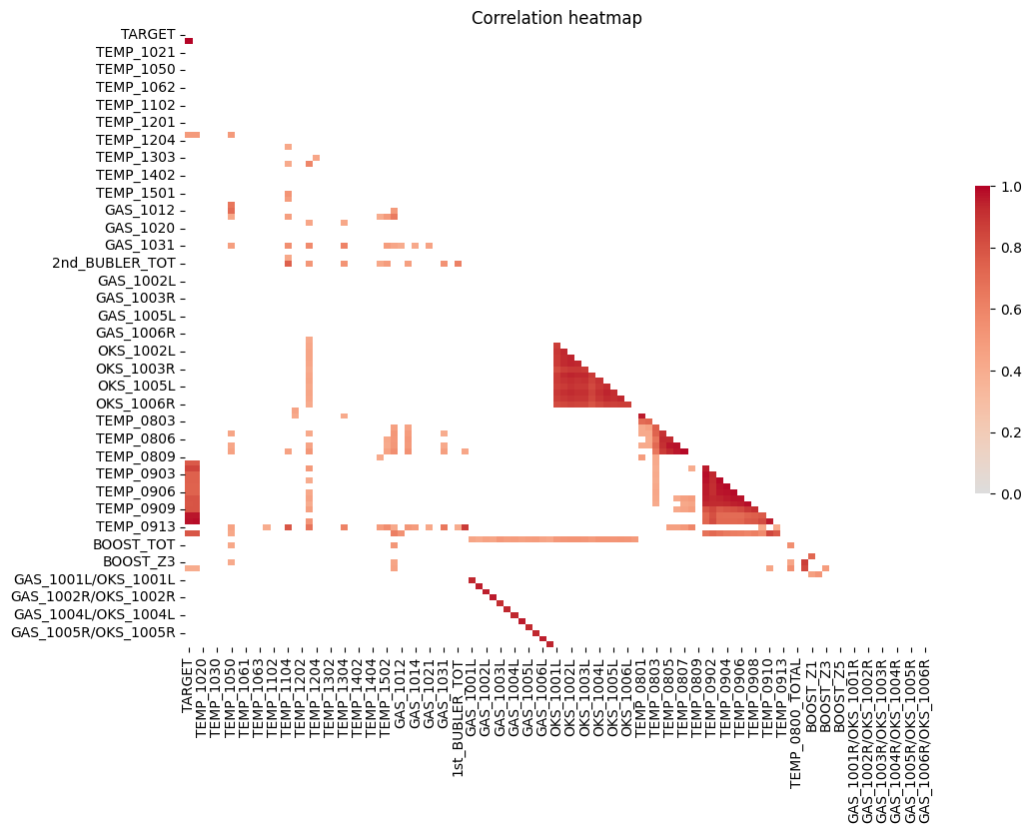
Correlation Matrix
This matrix which only shows the correlations above 0.4, shows us that there are a lot of group of features where they are highly correlated to each other.
We must remove all features except 1 of them for each group of highly correlated features, because regression assumes independent features.
We also drop columns where the correlation to any of the features in nan. It means they are constant.

Slide 17
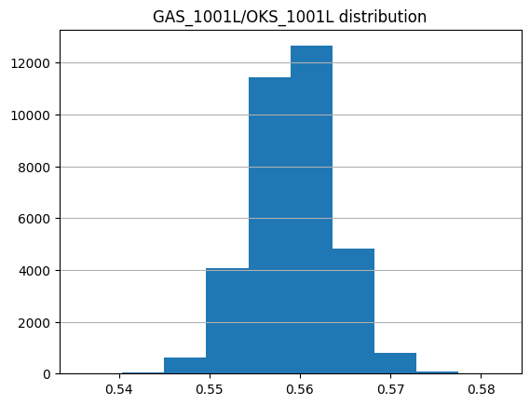
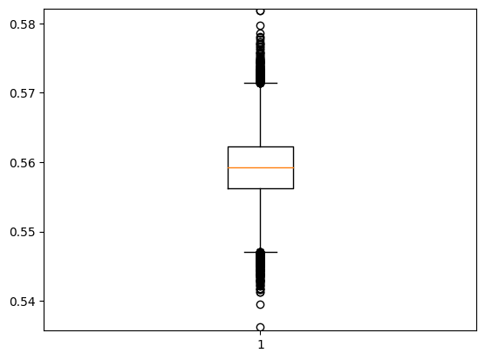
Analysis of Gas/Oxygen Columns
The histogram shows us that the data is distributed around the mean with low variance, and the box plot shows us that interquartile range is fairly narrow.

Slide 18
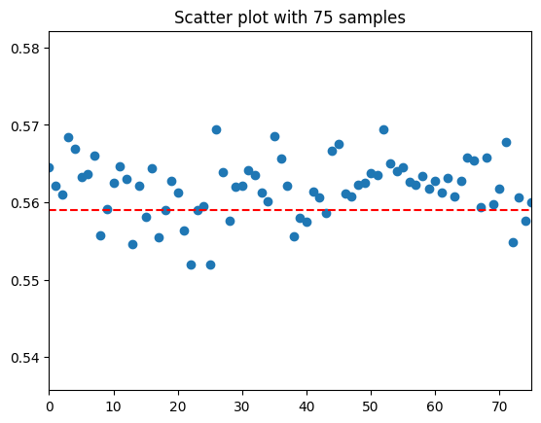
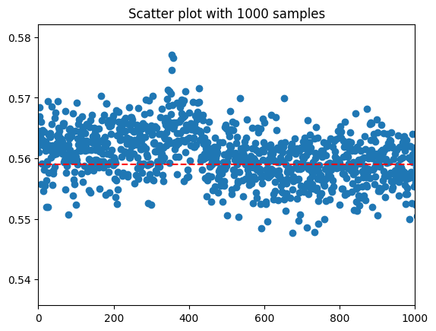
Analysis of Gas/Oxygen Columns
From the scatter plots below, we can understand that gas/oxygen ratio is getting fixed. Every time it moves away from the mean (red line), it stabilizes. We can even say it acts like a pendulum.

Slide 19
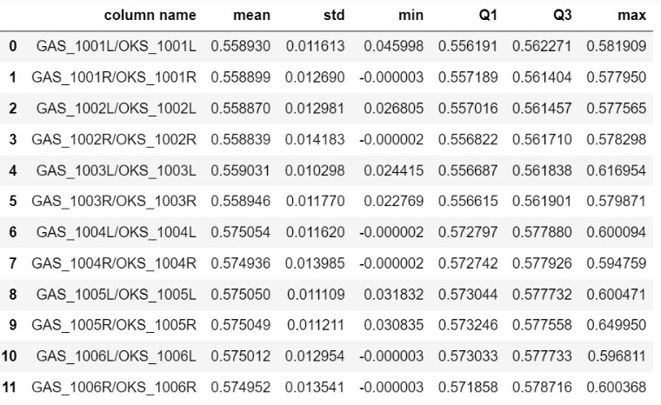
Analysis of Gas/Oxygen Columns
After comparing their statistics, we can say that all gas/oxygen columns are similar with
low standard deviation (around 0.12),
narrow interquartile range (both q1 and q3 is near mean)
very low minimum considering the overall distribution (we can think them as outliers)
The major difference between them is that half of them has average value around 0.558, and other half has average value around 0.575.

Slide 20
Data Preprocessing

Slide 21
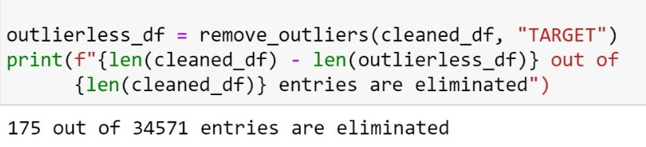
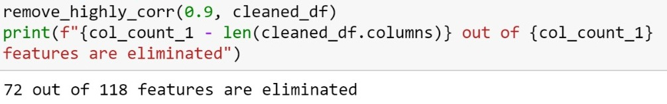
Feature Selection
Outlier Removal
From the correlation matrix, we know that we can divide most of the columns as groups of highly correlated features.
After storing highly correlated features, we keep only one of them, which is the one has the most correlation to target. We remove the others from the DataFrame.
Then we remove the entries which are outside of 1.5 IQR interval, also known as outliers.
We only check the Target variable for the removal process.

Slide 22
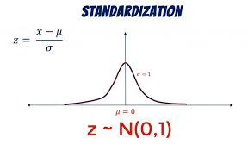
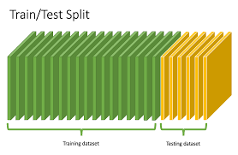
Standardization
Train/Test Split
Then we standardize the data with the formula below.
The important thing about the splitting is not doing it random, despite the conventional method. Because we have a time-based data, the order matters.
We simply take the first 80% of the data as train set, and the rest as test set. Now we are ready for modelling.

Slide 23
Modelling and Evaluation

Slide 24
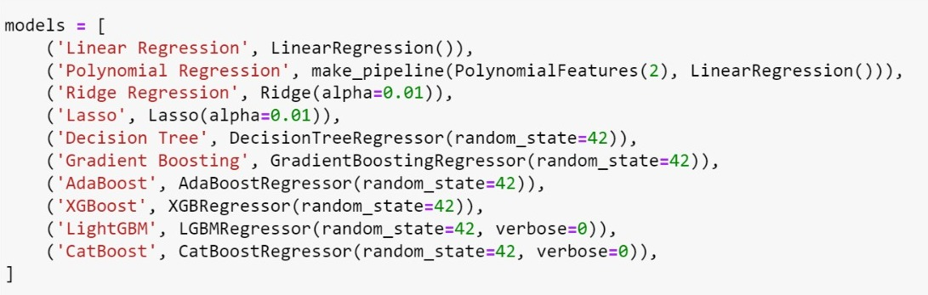
Modelling
Before deciding on our ultimate model, we should experiment on various regression models like simple linear regression, ridge regression, and some tree based models.

Slide 25
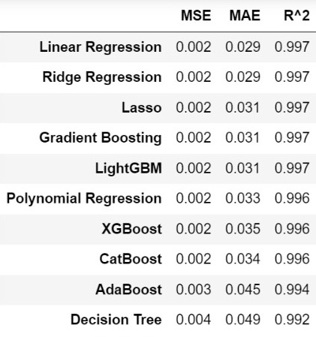
Evaluation
The results are incredible for all errors. We will check the feature importance but it’s probably because of TEMP_0912 column.
Older regression methods performed better than boosting algorithms, which is surprising.
Linear regression and ridge regression gives the same result, we choose linear regression as our final model because it’s the simpler one.
Since there is not a parameter to optimize in linear regression, we can just use it as the final model.

Slide 26
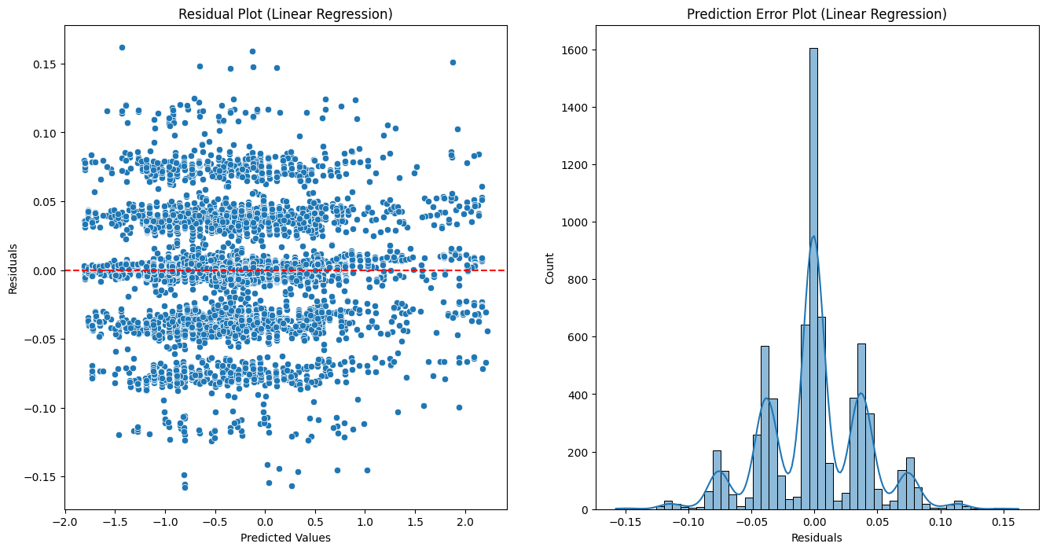
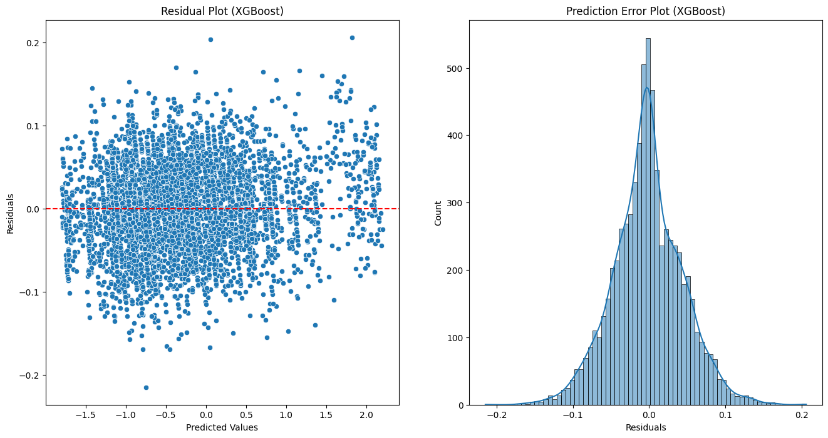
Residual Distributions
Residual distribution of linear regression model is strange. Normally, we except it to be normally distributed around the mean. But heaps got created around some points.
Residual distribution of XGBoost model looks more like what we expect it to be.

Slide 27
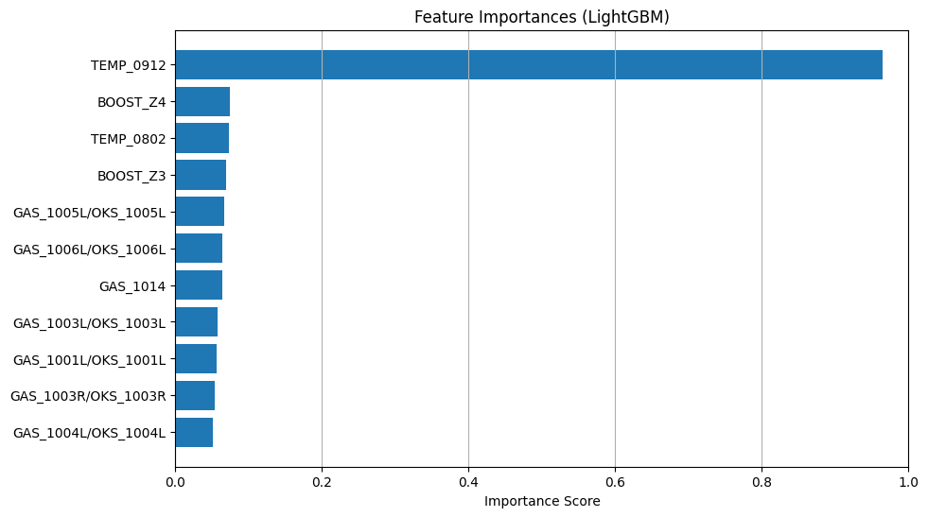
Feature Importance
Domination of TEMP_0912 feature is not surprising at all. It’s the predecessor of the Target variable after all.
The feature importance tells us that we were lucky to have the historical values of our target. Let’s check how our models would perform in the absence of such information.

Slide 28
Without TEMP_0912

Slide 29
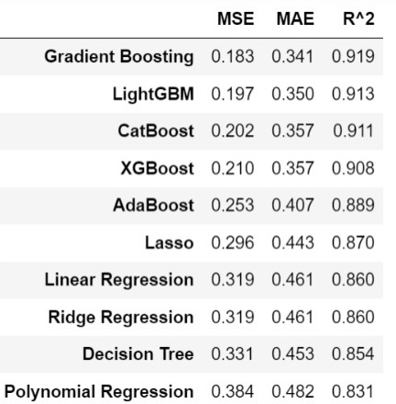
Evaluation
Let’s skip to the evaluation part because the process is exactly the same.
As expected, the performance for all models decreased. But the results are still satisfying, especially with R^2 error which is what we wanted, because we aim to optimize our model based on that.
This time, boosting algorithms perform better than older methods, and Gradient Boosting algorithms gives the best result for all errors.

Slide 30
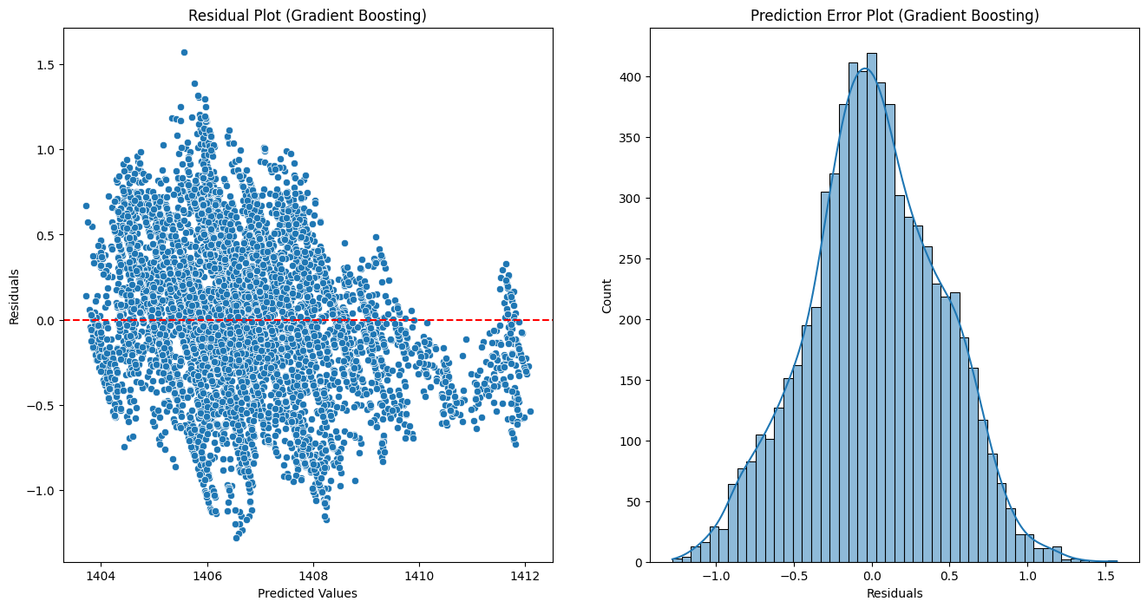
Residual Distributions
Residual distribution of Gradient Boosting model is looks more realistic than the previous ones. Maybe it doesn’t form a perfect normal distribution, but it’s close to it and it’s distributed around 0.

Slide 31
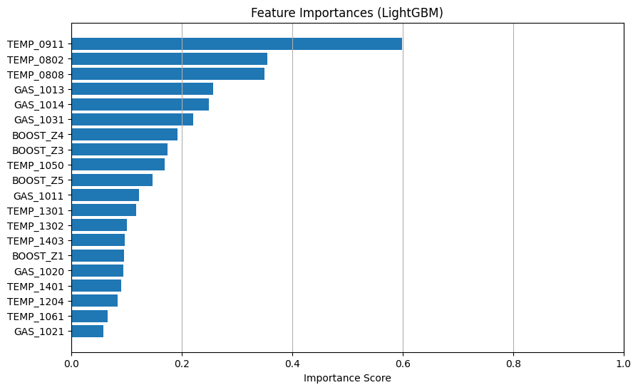
Feature Importance
Without TEMP_0912, feature importance is fairly shared among features.
TEMP_0911 is the most important feature, and it aligns with correlation results.
TEMP_0802, TEMP_0808, GAS_1013, and GAS_1014 are other important features.
Let’s optimize hyperparameters of Gradient Boosting next.

Slide 32
Hyperparameter Optimization

Slide 33
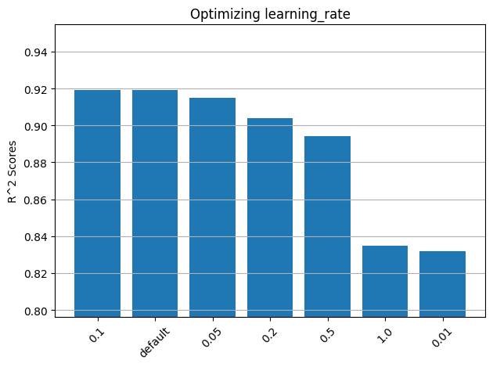
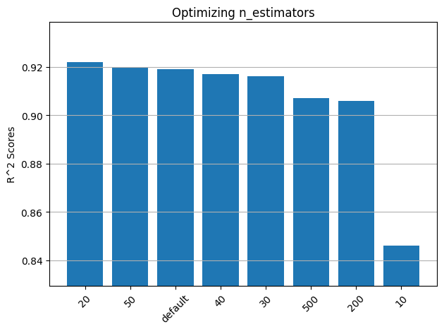
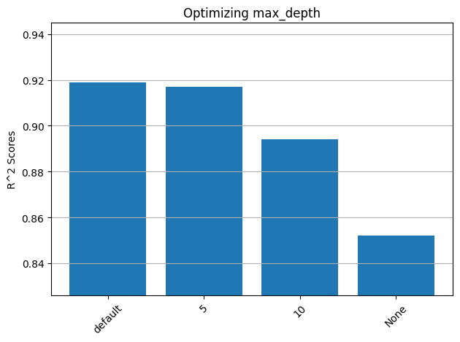
Hyperparameter Optimization
After fine-tuning 3 parameters (learning rate, n estimators, max depth) by fixing the other parameters, the results look like the bar plots below.
It turns out, learning rate and max depth parameters are best when they are default.
But we successfully improved the model’s performance by updating n_estimators as 20. R^2 score increases to 0.922 from 0.919.

Slide 34
Conclusion

Slide 35
Conclusion
With historical information of the target variable, all models outperformed every expectation, with simple linear regression as the best model.
Without such information, the performance of all models decreased but they were still satisfying enough. That means we can successfully predict the temperature of a specific location at the furnace at the next minute, using the data from other sensors. Gradient Boosting was the best model this time.
We were able to improve the performance of our model by updating n_estimators parameter to 20 from its default value 100.

